Slide 1
Shopping Cart
UI and Flow

Slide 2
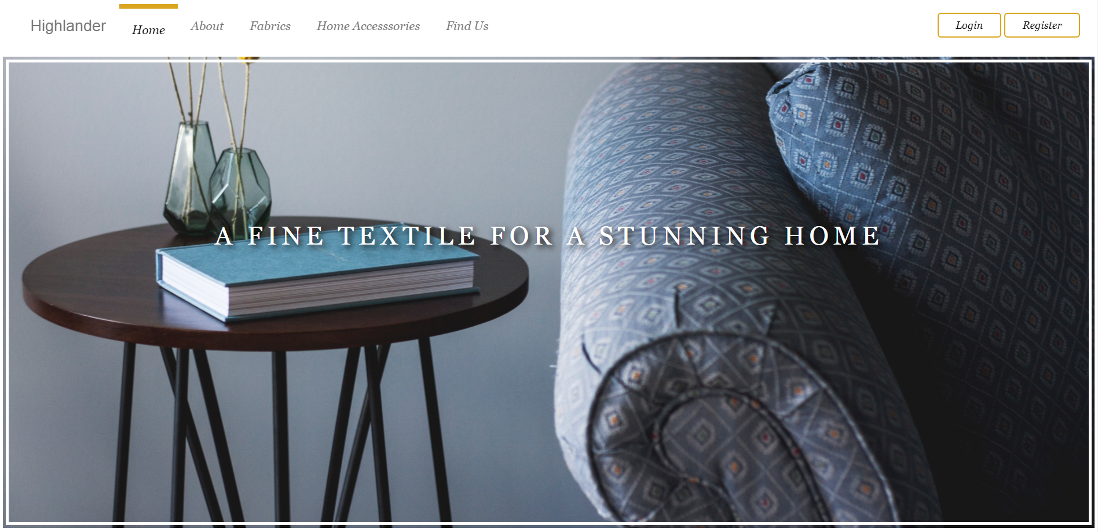

Shopping Cart Icon. When the user click on the icon, It will redirect the user to the summary page (slide 7)
Notes:
The number shows the number of orders

Slide 3
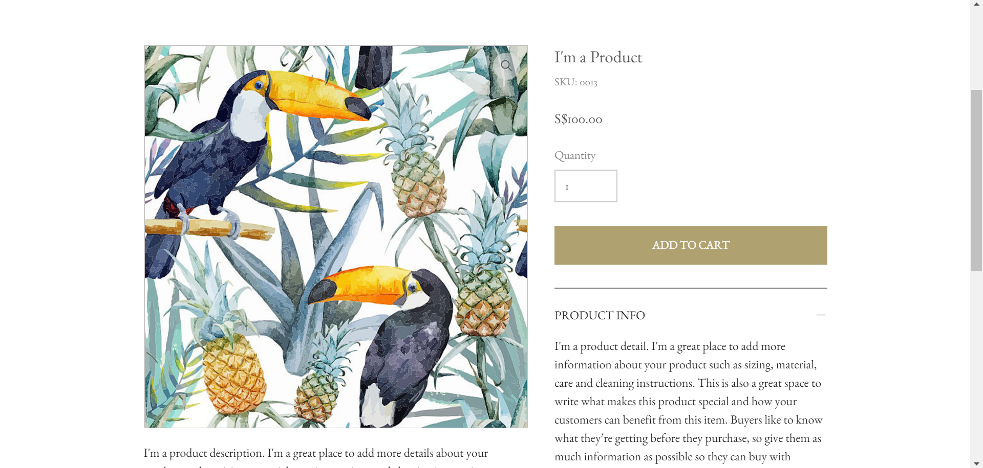
Add To Cart Button in both of quick view and full details page

Slide 4
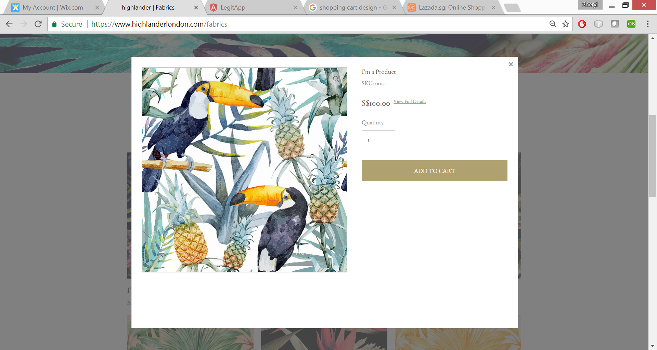
Add To Cart Button in both of quick view and full details page

Slide 5
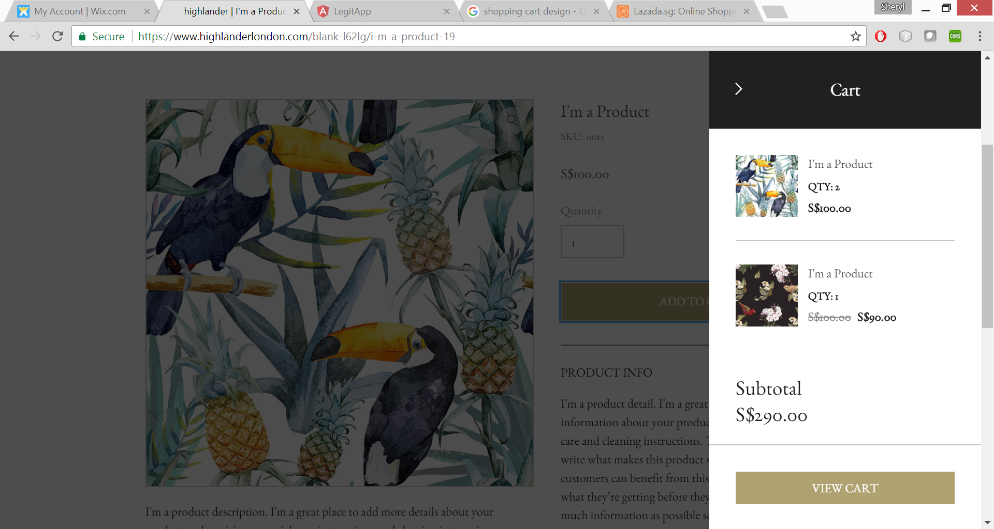
The View Cart Side bar will appear whenever the user add an item into the shopping cart.
The view cart will show all the order with the following information:
Pattern name
Pattern image
Quantity
Individual Price (combination price)
Subtotal of all product (combination X quantity).
View cart button will redirect to the summary page (slide 7)

Slide 6
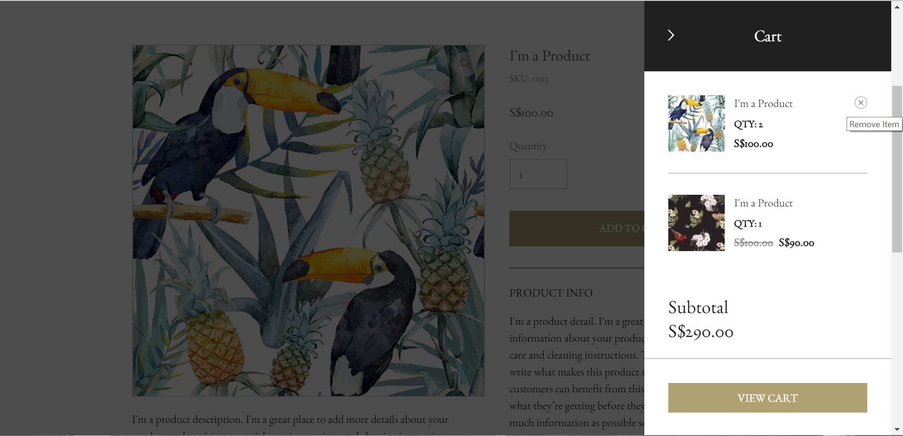
User will be able to remove items from the view cart list

Slide 7
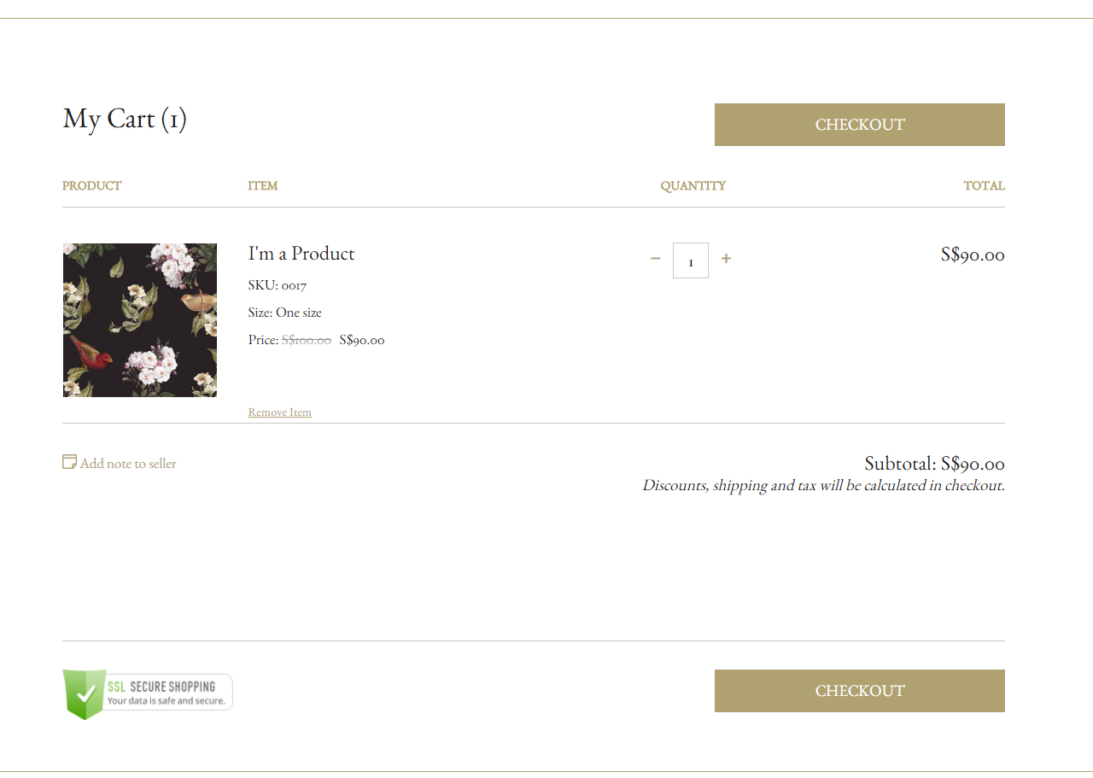

Slide 8
Quantity
Pattern Name
Pattern Code
Pattern Image
Material name
Colour
Size
Individual price X quantity
Able to remove items
Subtotal = total (individual X quantity)

